Slide 1



Classification: Internal
SonarQube Implementation
10/06/2026

Slide 2

SonarQube Implementation
Previous State (Before CI/CD Governance & SonarQube)
Challenges:
No standardized CI/CD governance framework across applications.
Code quality validation was largely manual and inconsistent.
Limited visibility of security, reliability, and maintainability metrics.
No automated enforcement of quality controls before deployment.
Pull Request approvals were performed without quality gate validation.
Inconsistent naming conventions and release traceability.
Business Impact:
Higher deployment risk.
Limited governance and compliance visibility.
Reactive defect detection.
Inconsistent quality standards across teams.
Reduced traceability between requirements, releases, and deployments.

Slide 3
SonarQube Implementation
Project Objectives
Standardize CI/CD governance, security controls, and quality enforcement across different applications.
Key Objectives:
Implement SonarQube Quality Gates.
Standardize CI/CD governance and quality controls.
Enforce code quality through SonarQube Quality Gates.
Integrate automated security and secret scanning.
Establish consistent naming and release management standards.
Improve traceability, compliance, and overall software quality.

Slide 4
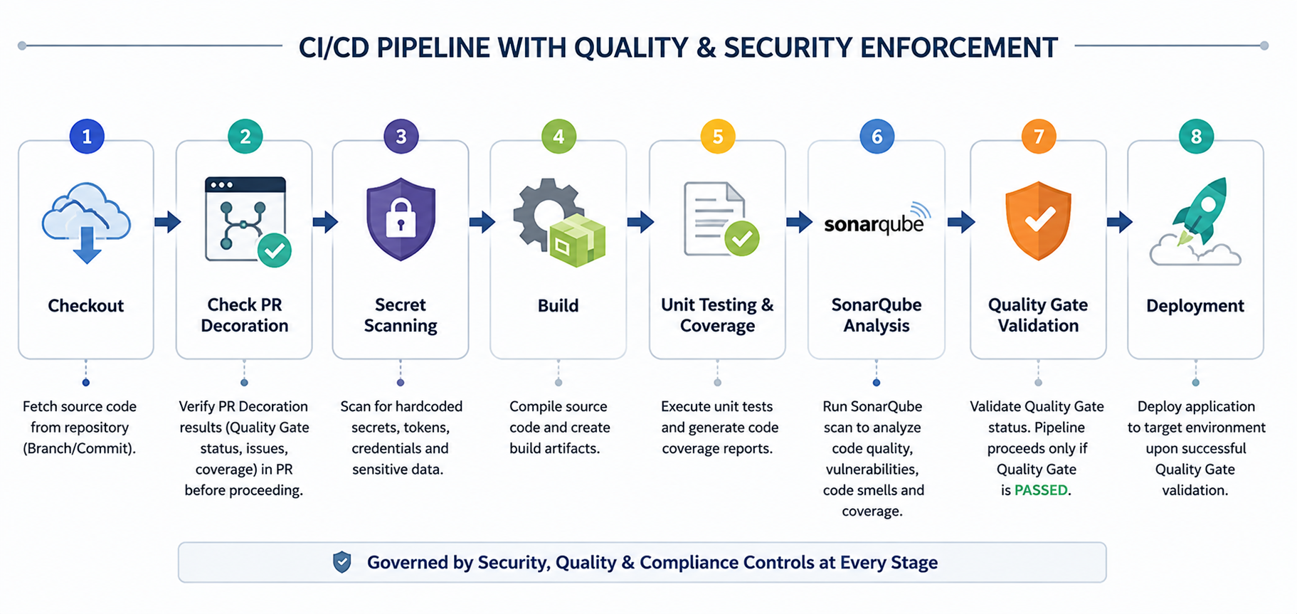
SonarQube Implementation
Target CI/CD Quality Governance

Slide 5
SonarQube Implementation
Naming Convention Standard
Current State
Release Name is currently aligned only with the EPIC Name.
Example: EPIC8033
Proposed Jenkins Release Naming Standard
Format:
<EPIC NAME> ⇔ R<ReleaseNumber>-<LOB>-v<Major.Minor.Patch>-<Environment>
Example:
EPIC8033 ⇔ R25-DXP-v1.0.0-DEV
SonarQube Project Naming Standard
Format:
<LOB>-<Jenkins Job Name>
Example:
DXP-BFF-AAMAL-ESERVICES
Benefits
Consistent naming across Jenkins and SonarQube.
Improved traceability between EPICs, releases, and applications.
Simplified reporting and governance.
Standardized portfolio management.

Slide 6
SonarQube Implementation
PR Decoration
Previous State (Before PR Decoration)
Pull Requests could be reviewed and approved without visibility of code quality results.
Current Usage:
Enabled for Pull Requests targeting DEV branch.
Displays SonarQube results directly in Bitbucket PRs.
Benefits:
Immediate feedback to developers.
Prevents merging low-quality code.
Faster code review process.
Enforces Quality Gates before approval.
Improves code review efficiency and governance.
Stronger alignment with ITQMS quality controls.

Slide 7
SonarQube Implementation
Overall Status
Project | Bugs | Vulnerabilities | Code Smells | Coverage % | Duplications % | Security
Life OTP | 17 | 0 | 37 | 85.6 | 0 | 0
Sales Motor V3 | 7 | 0 | 100 | 50.5 | 16.2 | 0
BFF Web | 0 | 0 | 20 | 45.6 | 7.5 | 0
Visit Visa V3 | 2 | 0 | 91 | 55.3 | 1.5 | 0
Travel Insurance V3 | 13 | 0 | 131 | 44.3 | 6.9 | 0
Recovery Portal V3 | 0 | 0 | 28 | 42.7 | 11.4 | 0
Workshop Portal V3 | 4 | 0 | 179 | 43 | 11.9 | 0

Slide 8
SonarQube Implementation
Coverage Status
Condition
>= 40%
Coverage by project

Slide 9
SonarQube Implementation
Code Duplication Status
Condition
<= 20%
Code Duplication by project

Slide 10
SonarQube Implementation
Reliability Issues (Bugs)
Condition
<= 300
Reliability Issues (Bugs) by Project

Slide 11
SonarQube Implementation
Maintainability Issues (Code Smells) by Project
Condition
<= 300
Maintainability Issues (Code Smells) by Project

Slide 12
SonarQube Implementation
Security Compliance
A
B
C
D
E
Best / very low risk
Low risk
Medium risk
High risk
Highest risk
Applications Assessed: 7
Security Rating A: 7/7
Vulnerabilities: 0
Quality Gate Compliance: 100%
Security Compliance

Slide 13
SonarQube Implementation
STATUS SUMMARY
SonarQube Implementation Summary
A total of 7 DXP applications were successfully onboarded to SonarQube, achieving 100% Quality Gate compliance across the portfolio.
All applications achieved Security Rating A and Maintainability Rating A, reflecting strong security controls and code quality standards. Reliability remains the main improvement area, with 5 applications rated C due to identified software defects, while 2 applications achieved Reliability Rating A.
Overall test coverage exceeded the minimum governance target of 40%, and all applications remained within the approved code duplication threshold.
Key Observations
7 applications onboarded successfully.
100% Quality Gate compliance achieved.
100% Security Rating A.
100% Maintainability Rating A.
Reliability improvements required in 5 applications.
Life OTP and Travel Insurance V3 have the highest number of identified bugs.
Workshop Portal V3 has the highest technical debt (code smells).

Slide 14
Classification: Internal
Thank You
Taking the Technology & Digital
to the Next Level

